Slide 1
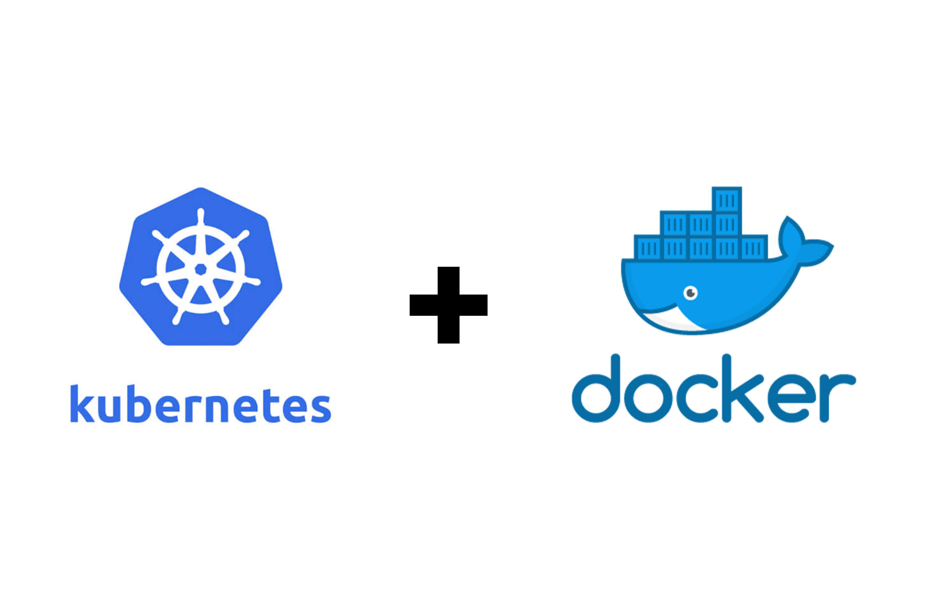
Kubernetes And Docker
With Spring Boot example:
Git hub url: https://github.com/VijayKode/Kubernetes.git

Slide 2
Course Outline
What is Docker? What is the need?
Docker Architecture and its components.
What is Kubernetes and what is the need
Working with Docker and Kubernetes.
Kubernetes Internal architecture and its components.

Slide 3
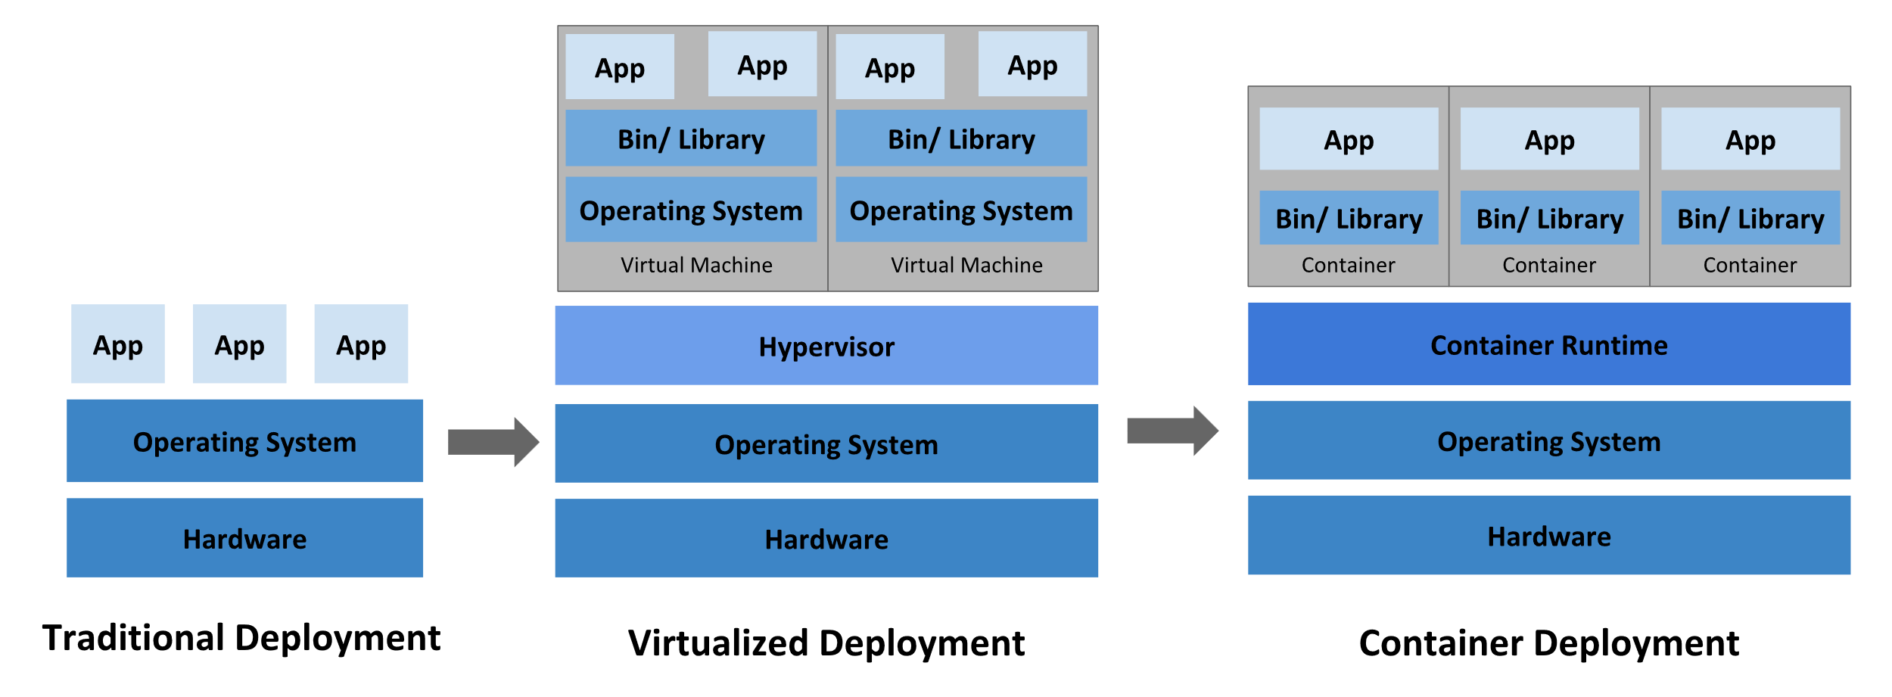
Container Evolution
Traditional deployment: There was no way to define resource boundaries, if multiple applications run on a physical server, there can be instances where one application would take up most of the resources. Virtualized Deployment: As a solution, virtualization was introduced. It allows you to run multiple Virtual Machines (VMs) on a single physical server's CPU. Virtualization allows better utilization of resources in a physical server and allows better scalability. Container Deployment: Containers are similar to VMs, but they have relaxed isolation properties to share the Operating System (OS). They are decoupled from the underlying infrastructure, they are portable across clouds and OS distributions

Slide 4
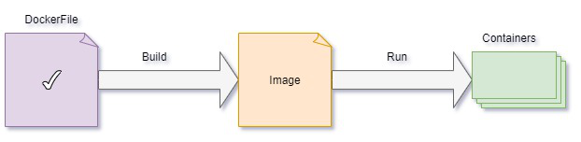
Docker
Docker - Docker is an open platform for developing, shipping, and running applications. It helps in shipping, testing, and deploying code quickly.
Components – Container and Image.
Container – Container is a lightweight environment, It contains all the dependencies required to run the application, so you do not need to rely on what is currently installed on the host.
Image - Docker Image is an executable package of software that includes everything needed to run an application. This image informs how a container should instantiate, determining which software components will run and how.
Simply we can consider, image is source code of a container and container is a runnable instance of an image.
Reference : https://docs.docker.com/get-started/overview/#docker-objects https://www.geeksforgeeks.org/what-is-docker-images/

Slide 5
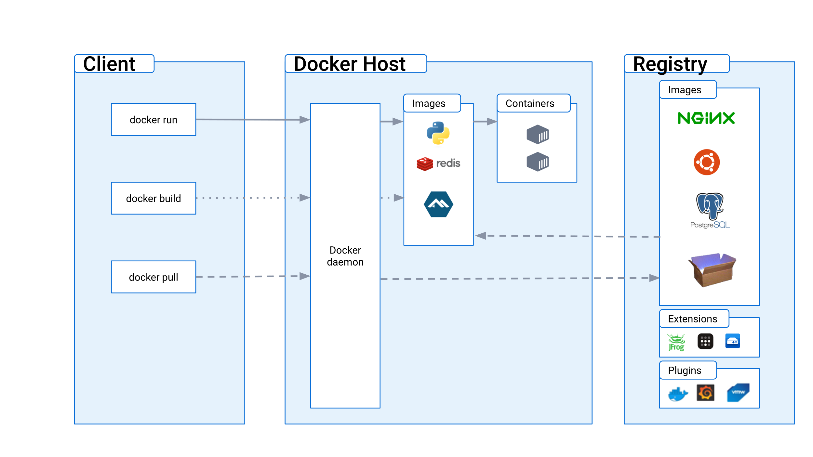
Docker Architecture

Slide 6
Docker Components
The Docker daemon
The Docker daemon (dockerd) listens for Docker API requests and manages Docker objects such as images, containers, networks, and volumes. A daemon can also communicate with other daemons to manage Docker services.
The Docker client
The Docker client (docker) is the primary way that many Docker users interact with Docker. When you use commands such as docker run, the client sends these commands to Docker daemon (dockerd), which carries them out. The docker command uses the Docker API. The Docker client can communicate with more than one daemon.
The Docker client and daemon communicate using a REST API
Docker Desktop
Docker Desktop is an easy-to-install application for your Mac, Windows or Linux environment that enables you to build and share containerized applications and microservices.
Docker registries
A Docker registry stores Docker images. Docker Hub is a public registry that anyone can use, and Docker is configured to look for images on Docker Hub by default. You can even run your own private registry.

Slide 7
Docker File
FROM openjdk:17 VOLUME /tmp EXPOSE 8080 ARG JAR_FILE=build/libs/test-0.0.1-SNAPSHOT.jar ADD ${JAR_FILE} app.jar ENTRYPOINT ["java","-jar","/app.jar"]
FROM -- Instruction to the docker that you wanted to start building from the openjdk:17 image.
VOLUME -- instruction is used to specify a mount point for a volume within the container. The volume will be created when the container is built, and it can be accessed and modified by processes running inside the container .
EXPOSE – we are exposing the port 8080 to communicate to application.
ADD -- command is used to copy files/directories into a Docker image.
ENTRYPOINT -- Instruction to provide executables that will always execute when the container is launched.

Slide 8
DOCKER
Docker build command: docker build -t ImageName:TagName dir
Ex : docker build -t ImageName:TagName dirdocker build –t myimage:0.1 .
Since the Docker File is in the present working directory, we used "." at the end of the command to signify the present working directory.
Docker Run Command : docker run [OPTIONS] IMAGE [COMMAND] [ARG...]
EX: docker run -p 8080:8080 imgone:123
‘- P’ -- This binds port 8080 of the container to TCP port 80 of the host machine

Slide 9
Kubernetes
Kubernetes is a portable, extensible, opensource platform for managing containerized workloads and services, that facilitates both declarative configuration and automation.
The name Kubernetes originates from Greek, meaning helmsman or pilot. K8s as an abbreviation results from counting the eight letters between the "K" and the "s“.

Slide 10
Need of Kubernetes
What is the need of Kubernetes?
Containers are a good way to bundle and run your applications. In a production environment, you need to manage the containers that run the applications and ensure that there is no downtime.
Kubernetes provides you with:
Service discovery and load balancing
Kubernetes can expose a container using the DNS name or using their own IP address. If traffic to a container is high, Kubernetes is able to load balance and distribute the network traffic so that the deployment is stable.
Storage orchestration
Kubernetes allows you to automatically mount a storage system of your choice, such as local storages, public cloud providers, and more.
Automated rollouts and rollbacks
You can describe the desired state for your deployed containers using Kubernetes, and it can change the actual state to the desired state at a controlled rate. For example, you can automate Kubernetes to create new containers for your deployment, remove existing containers and adopt all their resources to the new container.
Self-healing
Kubernetes restarts containers that fail, replaces containers, kills containers that don't respond to your user-defined health check, and doesn't advertise them to clients until they are ready to serve.
Secret and configuration management
Kubernetes lets you store and manage sensitive information, such as passwords, OAuth tokens, and SSH keys. You can deploy and update secrets and application configuration without rebuilding your container images, and without exposing secrets in your stack configuration.

Slide 11
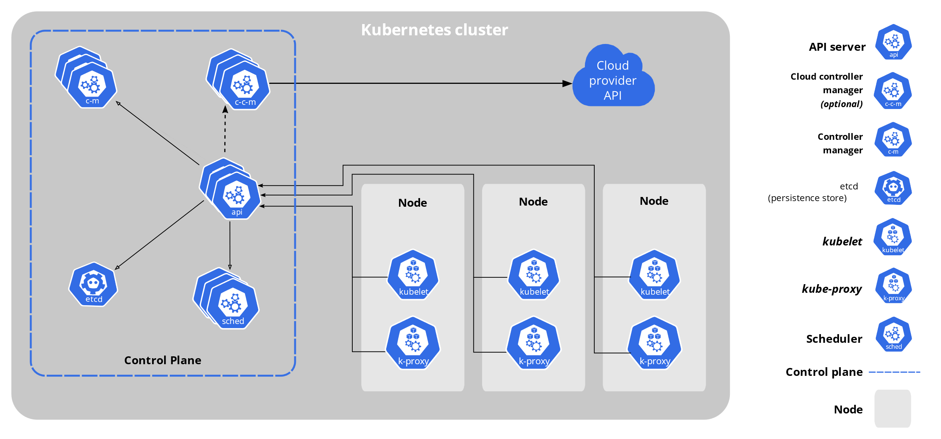
Kubernetes Architecture

Slide 12
Kubernetes Components
A Kubernetes cluster consists of a set of worker machines, called nodes, that run containerized applications. Every cluster has at least one worker node.
The worker node(s) host the Pods that are the components of the application workload. The control plane manages the worker nodes and the Pods in the cluster.
Control Plane Component:
Detecting and responding to cluster events (for example, starting up a new pod when a deployment's replicas field is unsatisfied).
kube-apiserver
The API server is a component of the Kubernetes control plane that exposes the Kubernetes API. The API server is the front end for the Kubernetes control plane.

Slide 13
Kubernetes Components
kube-scheduler:
Control plane component that watches for newly created Pods with no assigned node, and selects a node for them to run on.
kube-controller-manager:
Control plane component that runs controller processes.
Some types of these controllers are:
Node controller: Responsible for noticing and responding when nodes go down.
EndpointSlice controller: Populates EndpointSlice objects (to provide a link between Services and Pods).
cloud-controller-manager:
A Kubernetes control plane component that embeds cloud-specific control logic. The cloud controller manager lets you link your cluster into your cloud provider's API, and separates out the components that interact with that cloud platform from components that only interact with your cluster.

Slide 14
Kubernetes Components
Kubelet:
An agent that runs on each node in the cluster. It makes sure that containers are running in a Pod.
The kubelet takes a set of PodSpecs that are provided through various mechanisms like yaml files and ensures that the containers described in those PodSpecs are running and healthy.
The Kubernetes API:
The core of Kubernetes' control plane is the API server. The API server exposes an HTTP API that lets end users, different parts of your cluster, and external components communicate with one another.
Most operations can be performed through the kubectl command-line interface. However, you can also access the API directly using REST calls.

Slide 15
Kubernetes Pods
Pods are the smallest deployable units of computing that you can create and manage in Kubernetes.
A Pod (as in a pod of whales or pea pod) is a group of one or more containers, with shared storage and network resources, and a specification for how to run the containers. A Pod's contents are always co-located and co-scheduled, and run in a shared context.

Slide 16
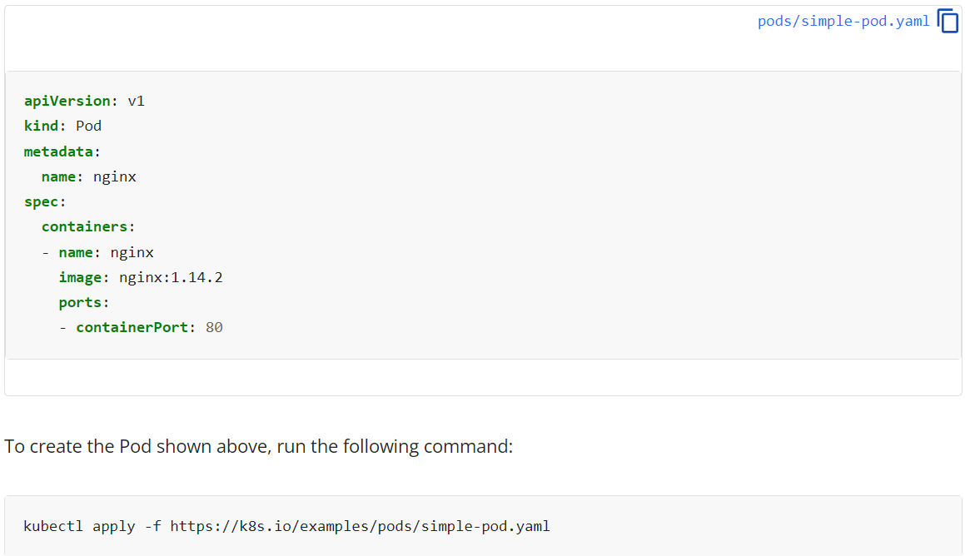
Kubernetes Pods

Slide 17
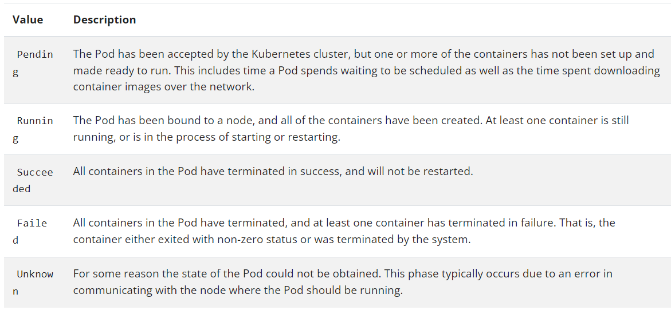
Kubernetes Pod Lifecycle

Slide 18
Kubernetes – Image pull policy
Image pull policy
The imagePullPolicy for a container and the tag of the image affect when the kubelet attempts to pull (download) the specified image.
IfNotPresent
the image is pulled only if it is not already present locally (node).
Always
every time the kubelet launches a container, the kubelet queries the container image registry to resolve the name to an image digest. If the kubelet has a container image with that exact digest cached locally, the kubelet uses its cached image; otherwise, the kubelet pulls the image with the resolved digest, and uses that image to launch the container.
Never
the kubelet does not try fetching the image. If the image is somehow already present locally, the kubelet attempts to start the container; otherwise, startup fails. See pre-pulled images for more details.

Slide 19
Common issues
Sometimes Pods will be in pending state for longer times– reason might be there are no enough resources.
Sometimes Pods will be in creating state for longer time– reason might be some error while pulling the image may be due to access denied or image in not available or there might be some typo in image name.
CrashloopbackOff – when containers are failing multiple times, then Kubernetes won’t restart them immediately, it will wait for some time before restarting. So, when one see CrashloopbackOff in error logs One should know that there is some problem with the container.

Slide 20
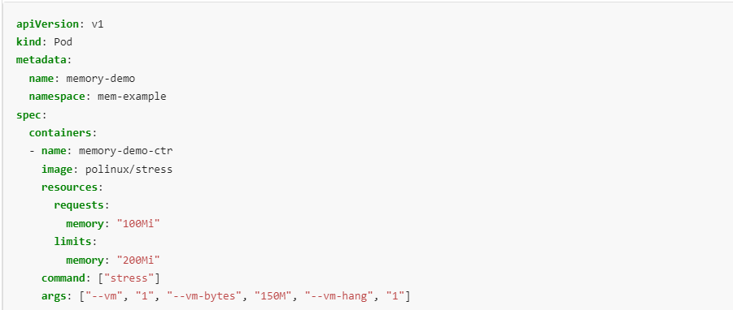
Memory requests
Create Name space: to isolate your resources in cluster from rest
kubectl create namespace mem-example
kubectl apply -f https://k8s.io/examples/pods/resource/memory-request-limit.yaml --namespace=mem-example
To specify a memory request for a Container under container resources field

Slide 21
View detailed information about the Pod:
kubectl get pod memory-demo --output=yaml --namespace=mem-example
The output shows that the one Container in the Pod has a memory request of 100 MiB and a memory limit of 200 MiB.
o/p:
resources:
requests:
memory: 100Mi
limits:
memory: 200Mi
Run kubectl top to fetch the metrics for the pod:
kubectl top pod memory-demo --namespace=mem-example
The output shows that the Pod is using about 162,900,000 bytes of memory, which is about 150 MiB. This is greater than the Pod's 100 MiB request, but within the Pod's 200 MiB limit.
o/p:
NAME CPU(cores) MEMORY(bytes)
memory-demo <something> 162856960

Slide 22
Exceed a Container's memory limit
A Container can exceed its memory request if the Node has memory available.
But a Container is not allowed to use more than its memory limit.
If a Container allocates more memory than its limit, the Container becomes a candidate for termination.
In the same pod specification chnage args to pass 250M which is above memory limit
args: ["--vm", "1", "--vm-bytes", "250M", "--vm-hang", "1"]
The Container in this exercise can be restarted, so the kubelet restarts it. Repeat this command several times to see that the Container is repeatedly killed and restarted:
Killed->restarted->killed-> restarted …… crashloopbackoff…….

Slide 23
kubectl get pod memory-demo-2 --namespace=mem-example
The output shows that the Container is killed, restarted, killed again, restarted again, and so on:
kubectl get pod memory-demo-2 --namespace=mem-example
NAME READY STATUS RESTARTS AGE
memory-demo-2 0/1 OOMKilled 1 37s
kubectl get pod memory-demo-2 --namespace=mem-example
NAME READY STATUS RESTARTS AGE
memory-demo-2 1/1 Running 2 40s
.
.
. OOMKilled -> out of memory killed

Slide 24
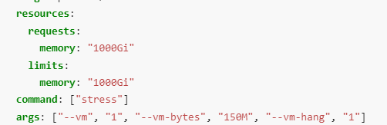
Specify a memory request that is too big for your Nodes
The memory request for the Pod is the sum of the memory requests for all the Containers in the Pod. Likewise, the memory limit for the Pod is the sum of the limits of all the Containers in the Pod.
Pod scheduling is based on requests. A Pod is scheduled to run on a Node only if the Node has enough available memory to satisfy the Pod's memory request if not it will be in pending status.
The output shows that the Pod status is PENDING. That is, the Pod is not scheduled to run on any Node, and it will remain in the PENDING state indefinitely:
kubectl get pod memory-demo-3 --namespace=mem-example
NAME READY STATUS RESTARTS AGE
memory-demo-3 0/1 Pending 0 25s

Slide 25
If you do not specify a memory limit
If you do not specify a memory limit for a Container, one of the following situations applies:
The Container has no upper bound on the amount of memory it uses. The Container could use all of the memory available on the Node where it is running which in turn could invoke the OOM Killer. Further, in case of an OOM Kill, a container with no resource limits will have a greater chance of being killed.
The Container is running in a namespace that has a default memory limit, and the Container is automatically assigned the default limit. Cluster administrators can use a LimitRange to specify a default value for the memory limit

Slide 26
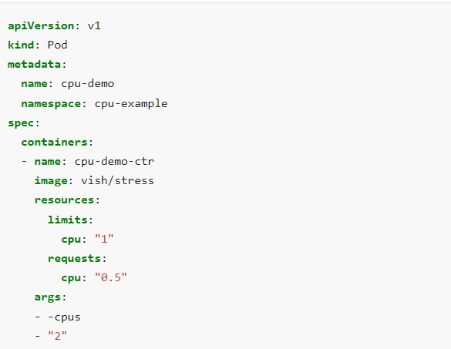
CPU
Just like memory, CPU can also be set to pod under resources of a container. Args are passed t container once it is started.

Slide 27
kubectl get pod cpu-demo --namespace=cpu-example
o/p:
resources:
limits:
cpu: "1"
requests:
cpu: 500m
kubectl top pod cpu-demo --namespace=cpu-example
This example output shows that the Pod is using 974 milliCPU, which is slightly less than the limit of 1 CPU specified in the Pod configuration.
NAME CPU(cores) MEMORY(bytes)
cpu-demo 974m <something>
Recall that by setting -cpu "2", you configured the Container to attempt to use 2 CPUs, but the Container is only being allowed to use about 1 CPU. The container's CPU use is being throttled, because the container is attempting to use more CPU resources than its limit.

Slide 28
In case of memory limit exceeds the limit OOM kil kiss the pod, but here CPU throttling will be used to control.
Similar to pods when CPU request is more than limit, pods will be not be schedule and will be in pending state.
When you don’t specify a limit container can take over entire CPU of a node and pod will not be killed unlike when a memory is exceeded., or when the namespace has default CPU limit set that will be used.

Slide 29
Configure Quality of Service for Pods
Kubernetes uses QoS classes to make decisions about evicting Pods when Node resources are exceeded.
When Kubernetes creates a Pod it assigns one of these QoS classes to the Pod:
Guaranteed -> every container has same CPU limit and request , has same memory request and limit
Burstable -> At least a container has memory or CPU limit or request
BestEffort -> every container must not have memory or CPU limit or request
Note: Qos class is given to pods not to containers

Slide 30
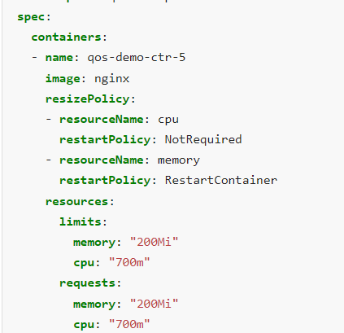
Resize CPU and Memory Resources assigned to Containers
A Kubernetes node allocates resources for a pod based on its requests, and restricts the pod's resource usage based on the limits specified in the pod's containers.
Container's application may be able to handle CPU resources resized without being restarted, but resizing memory may require that the application hence the containers be restarted
To enable this, the Container specification allows users to specify a resizePolicy. The following restart policies can be specified for resizing CPU and memory:
NotRequired: Resize the container's resources while it is running.
RestartContainer: Restart the container and apply new resources upon restart.

Slide 31
Thumb rule while updating pods:
While you can change a Pod's requests and limits to express new desired resources, you cannot change the QoS class in which the Pod was created.
Example, if u have guaranteed pod, if must specify same limit and request for CPU or memory
Since above screenshot is guaranteed pod while updating, we update like this
kubectl -n qos-example patch pod qos-demo-5 --patch '{"spec":{"containers":[{"name":"qos-demo-ctr-5", "resources":{"requests":{"cpu":"800m"}, "limits":{"cpu":"800m"}}}]}}'

Slide 32
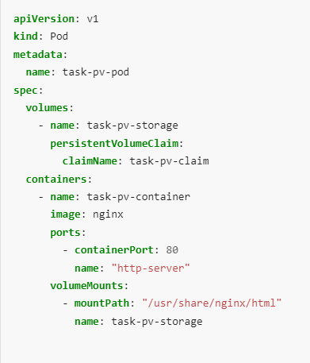
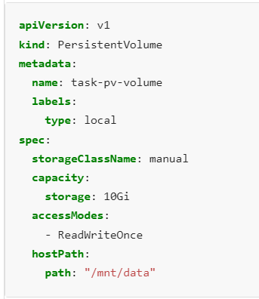
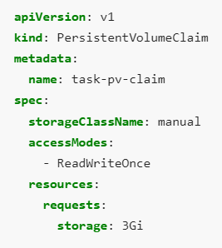
Persistent Volume
Define Persistent Volume
Define Persistent Volume Claim
Mount Persistent Volume claim on Pod
PV
PVC
Mount On Pods

Slide 33
StorageClass: -> will be used to bind PersistentVolumeClaim requests to this PersistentVolume.
ReadWriteOnce:
Allows multiple pods on the same node to simultaneously access a PV for reading and writing. This mode was previously used for workloads that required single-writer access to storage, but it could pose a risk for applications that need strict single-writer access for data safety.
ReadWriteOncePod:
Restricts access to a single pod on a single node, ensuring that only one pod can write to the volume at any time. This mode is a more restrictive version of RWO.
Note: Pods use PersistentVolumeClaims to request physical storage.

Slide 34
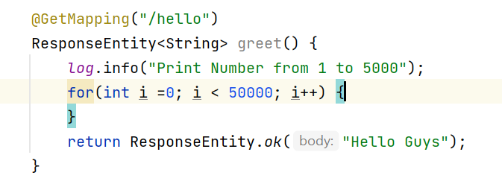
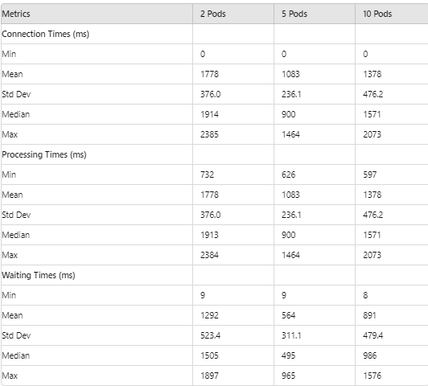
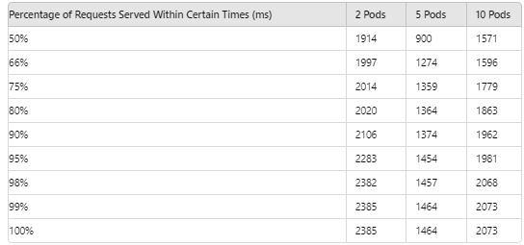
BenchMarks
ab -n 100 -c 100 -s 200 http://localhost:8080/hello 5pods 512 mem 500m cpu ,limits: 1024 m 1cpu
100 request 100 parallel
BenchMark results with 2pods , 5pods ,
10 pods of same endpoint(which runs
empty loop 50000 iterations) and gives response.

Slide 35
Conclusion
2pod -> 5pods processing time decreased
5 pods -> 10pods processing time increased, reasons are given below.
Resource Contention:
Shared Resources: More pods may lead to increased contention for shared resources like CPU and memory, particularly if the underlying infrastructure is not scaled to handle the increased load.
Load Balancer and Networking:
Distribution Issues: The load balancer might become less efficient as the number of pods increases, leading to uneven distribution of traffic and potential bottlenecks.
Network Overhead: More pods mean increased network communication overhead, which can impact performance.

Slide 36
Cont..
Concurrency Handling: The application might not handle high levels of concurrency efficiently, leading to increased response times as more pods are added.
Synchronization and Coordination: More pods can introduce overhead in terms of synchronization and coordination, which might affect performance.
Pod Management Overhead: Managing a larger number of pods can introduce additional overhead in terms of startup and shutdown times, potentially affecting performance.

Slide 37
Service Account in Kubernetes
A service account provides an identity for processes that run in a Pod, and maps to a ServiceAccount object. When you authenticate to the API server, you identify yourself as a particular user.
Every Kubernetes namespace contains at least one ServiceAccount: the default, ServiceAccount for that namespace, named default. If you do not specify a ServiceAccount when you create a Pod, Kubernetes automatically assigns the ServiceAccount named default in that namespace.
An application running inside a Pod can access the Kubernetes API using automatically mounted service account credentials.
If you don't want the kubelet to automatically mount a ServiceAccount's API credentials, you can opt out of the default behavior. You can opt out of automounting API credentials of a service account by setting automountServiceAccountToken: false

Slide 38
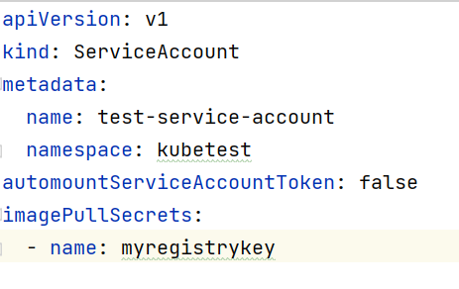
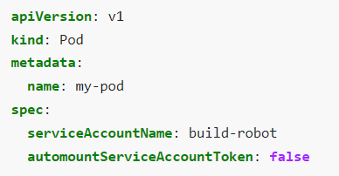

At ServiceAccountLevel At PodLevel
You can also opt out of automounting API credentials for a particular Pod, If both the ServiceAccount and the Pod's .spec specify a value for automountServiceAccountToken, the Pod spec takes precedence.
You can specify imagePullSecret in serviceAccountSpecification, this allows pods to authenticate with docker registry before pulling images.
Creating secret: ( if you don’t specify –docker-server, it uses current docker hub..)
kubectl create secret docker-registry myregistrykey --docker-server=<registry name> \
--docker-username=DUMMY_USERNAME --docker-password=DUMMY_DOCKER_PASSWORD \
--docker-email=DUMMY_DOCKER_EMAIL
You need not explicitly mention imagepullsecrets in pod, if your service account has imagepullsecret , it will be used by pod.

Slide 39
Configure Liveness, Readiness and Startup Probes
Liveness:
The kubelet uses liveness probes to know when to restart a container. For example, liveness probes could catch a deadlock, where an application is running, but unable to make progress. Restarting a container in such a state can help to make the application more available.
Readiness:
The kubelet uses readiness probes to know when a container is ready to start accepting traffic. A Pod is considered ready when all of its containers are ready. One use of this signal is to control which Pods are used as backends for Services. When a Pod is not ready, it is removed from Service load balancers.
Startup Probes:
kubelet uses startup probes to know when a container application has started. If such a probe is configured, liveness and readiness probes do not start until it succeeds, which helps slow starting container from being killed or restarted.

Slide 40
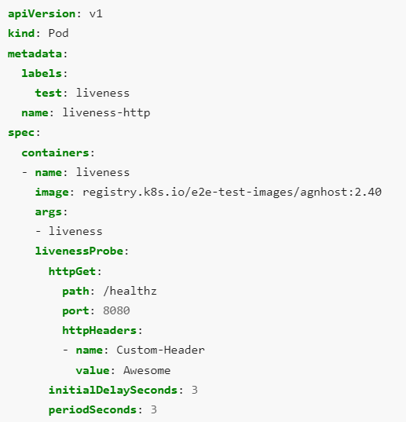
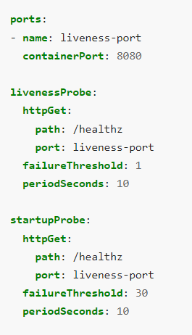
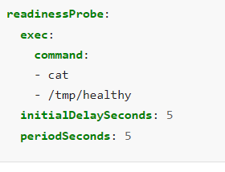
See startup probe config , the application will have a maximum of 5 minutes (30 * 10 = 300s) to finish its startup.
For an HTTP probe, the kubelet sends an HTTP request to the specified port and path to perform the check.
Other type of endpoints are Tcp and gRPC.
Readiness httpGet is similar object structure to lieness probe, you can use that.

Slide 41
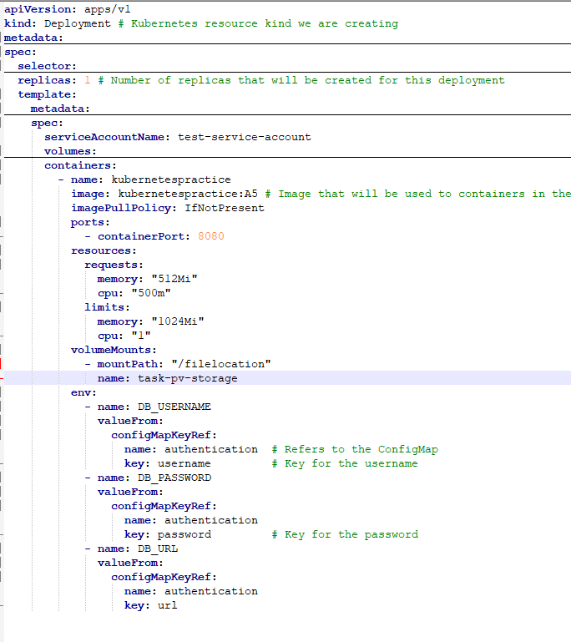
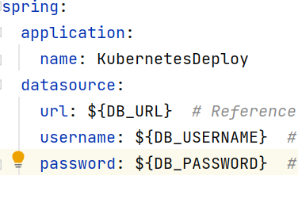
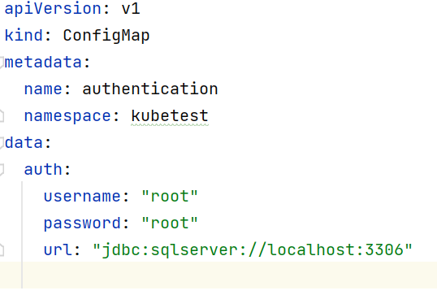




Configure a Pod to Use a ConfigMap
You can pass data at run time to a pod
by using configMap.
application.yaml
Config map
Deployment spec

Slide 42
Thank You.
Now you are good with Kubernetes.
-- Vijay Kode

